Slide 1
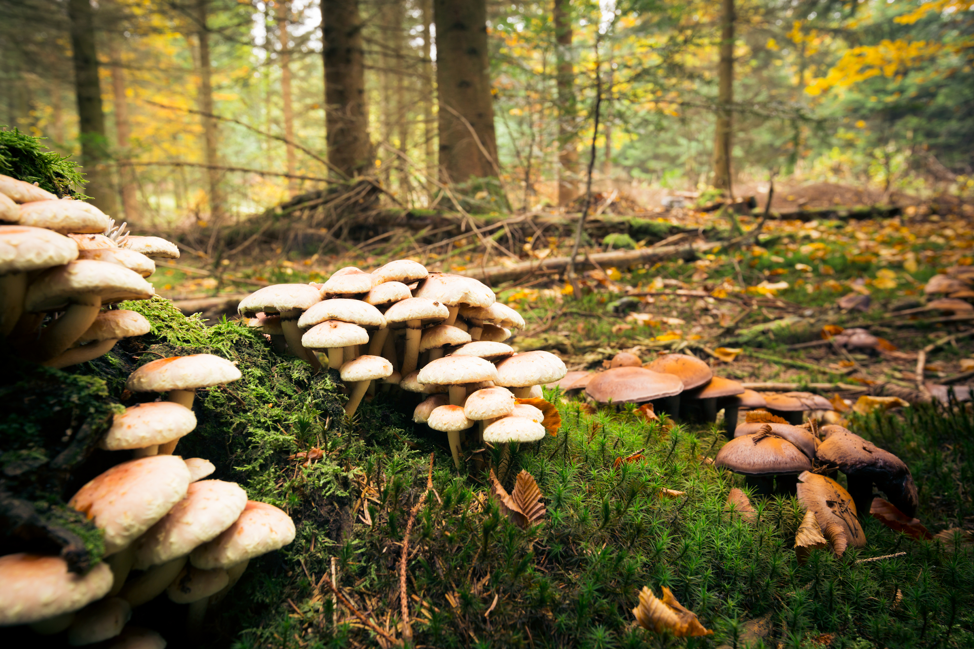
Shrooms
AI Boot Camp: Project 2 / Group 1
Team Members:
1. LaShawn Sykes
2. Aaron Cranor
3. Darcy DeBord
4. Stephen Martinez

Slide 2
Executive Summary
Objectives:
Evaluate performance of multiple ML models (Random Forest, Logistic Regression, KNN, SVC) for classifying mushrooms as edible or poisonous
Findings:
Random Forest model outperformed other models in accuracy, precision, recall, and F1 score
Notes:
La Shawn:
The LADS team conducted a study to evaluate the performance of multiple machine-learning models in classifying mushrooms as edible or poisonous.
We explored the use of Random Forest, Logistic Regression, KNN, and SVC, and found that the Random Forest model outperformed the others in terms of accuracy, precision, recall, and F1 score.
Based on these findings, the study recommends the development of an application that leverages the Random Forest model as the primary classifier, with the potential integration of Logistic Regression, KNN, and SVC for ensemble learning. This approach aims to provide foragers with a reliable tool to identify poisonous and edible mushrooms, thereby enhancing foraging safety and decision-making.
Please relax and listen to the rest of the LADS explain in detail what we accomplished.
Next Slide Please

Slide 5
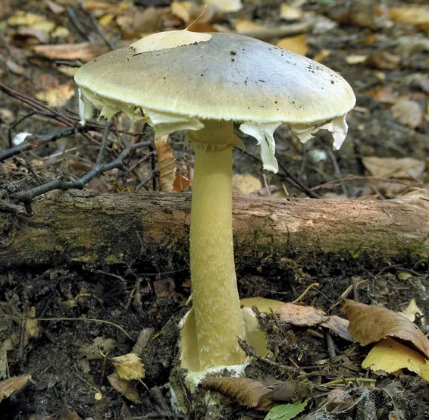
Death Cap (Amanita Phalloides)
POISONOUS
> One of the deadliest of all mushrooms.
> Closely resembles edible mushrooms such as straw and caesar’s.
> Within 6 to 12 hours after consumption, violent abdominal pain, vomiting, and bloody diarrhea appear. This leads to coma and death in more than 50% of recorded incidents.

Slide 6
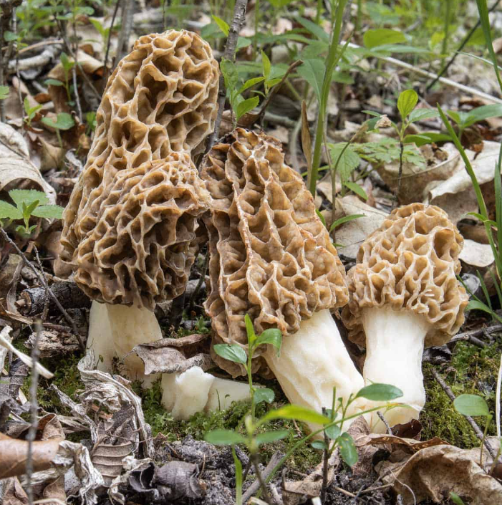
Common Riverbank morels (Morchella Americana)
EDIBLE
> Rich flavor and unmistakable meaty texture.
> One of the most famous mushrooms in the world.
> Rare, with a high retail price, morel season is short and hunting patches are often passed down in families like heirlooms

Slide 7
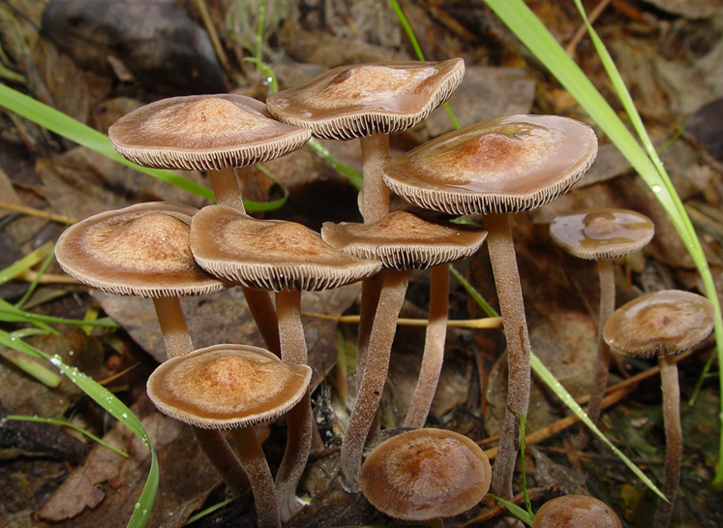
Banded Mottlegill (Panaeolus Cinctulus)
EDIBLE
> A type of psilocybin mushroom which contain hallucinogenic substances.
>

Slide 8
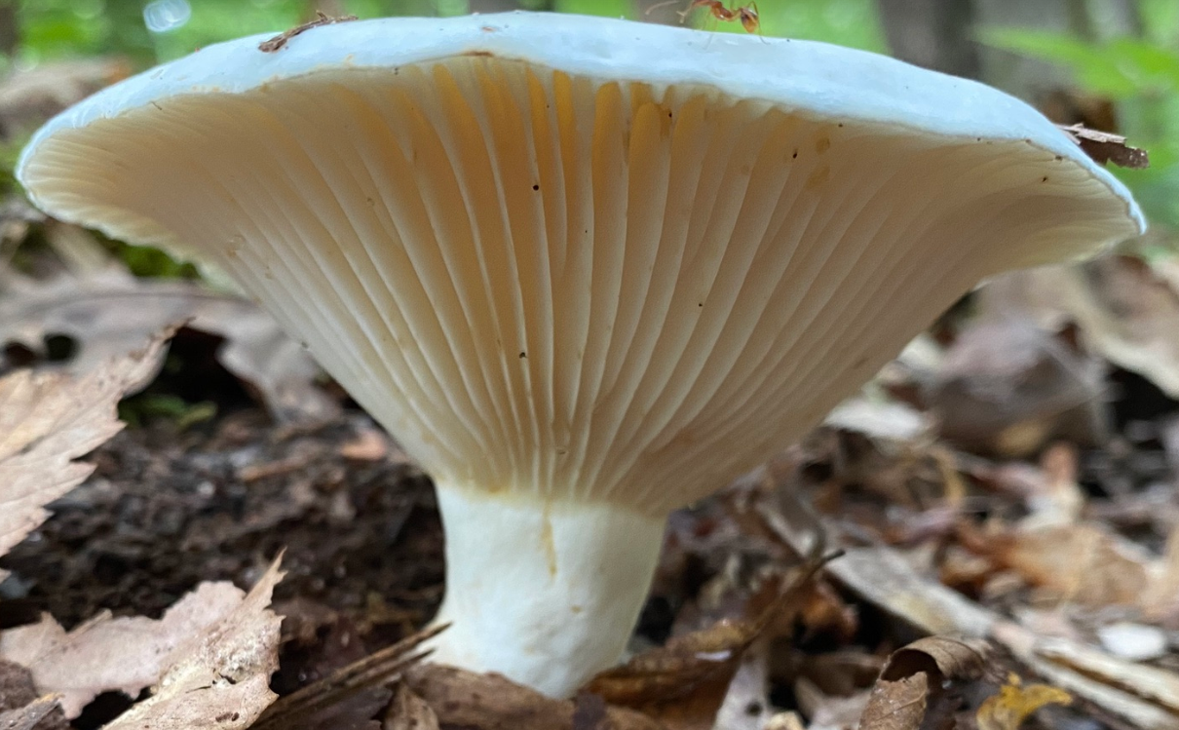

Slide 11


Slide 14
An executive summary or overview of the project and project goals. (5 points)
Objectives:
Evaluate performance of multiple ML models (Random Forest, Logistic Regression, KNN, SVC) for classifying mushrooms as edible or poisonous
Findings:
Random Forest model outperformed other models in accuracy, precision, recall, and F1 score
Notes:
La Shawn:
The LADS team conducted a study to evaluate the performance of multiple machine learning models in classifying mushrooms as edible or poisonous.
The researchers explored the use of Random Forest, Logistic Regression, KNN, and SVC, and found that the Random Forest model outperformed the others in terms of accuracy, precision, recall, and F1 score.
Based on these findings, the study recommends the development of an application that leverages the Random Forest model as the primary classifier, with the potential integration of Logistic Regression, KNN, and SVC for ensemble learning.
This approach aims to provide foragers with a reliable tool to identify poisonous and edible mushrooms, thereby enhancing foraging safety and decision-making.

Slide 15
DATA COLLECTION, CLEAN UP, & EXPLORATION
We sources two datasets from

Slide 16
The approach that your group took in achieving the project goals. (5 points)

Slide 17
Any additional questions that surfaced, what your group might research next if more time was available, or share a plan for future development. (3 points)

Slide 18
The results and conclusions of the application or analysis. (3 points)

Slide 19
What problem does the project attempt to solve?

Slide 20
How does the project solve this problem at a high-level ?

Slide 21
What steps were taken to develop the project

Slide 22
Demonstrate how the project solves the problem, as outlined in the narrative. Discuss any additional steps that might be taken to enhance the project in future iterations

Slide 24
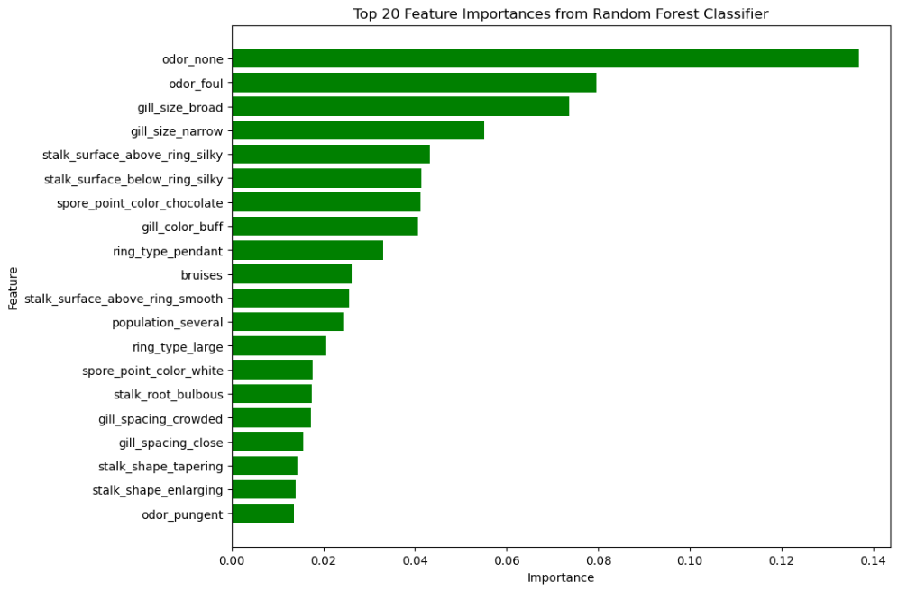

Slide 25
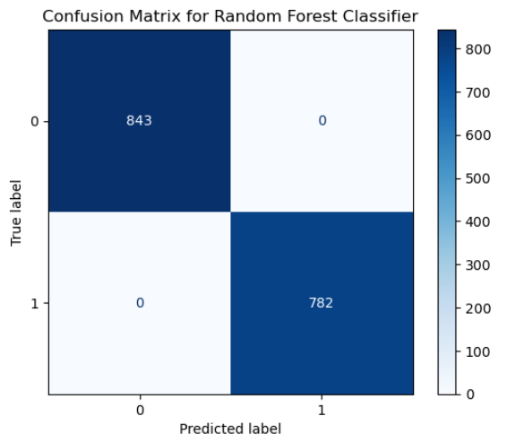
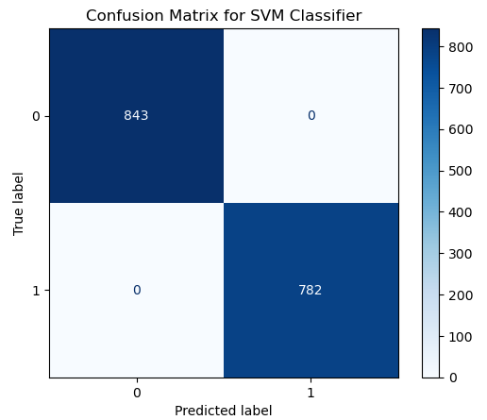

Slide 26
